Slide 1


Introduction to Artificial Intelligence
David Ellison, PhD | 2018-19-22
2018 Lenovo Internal. All rights reserved.

Slide 2
Artificial Intelligence Defined: “What you don’t expect a computer to be able to do”
2018 Lenovo Internal. All rights reserved.

Slide 3
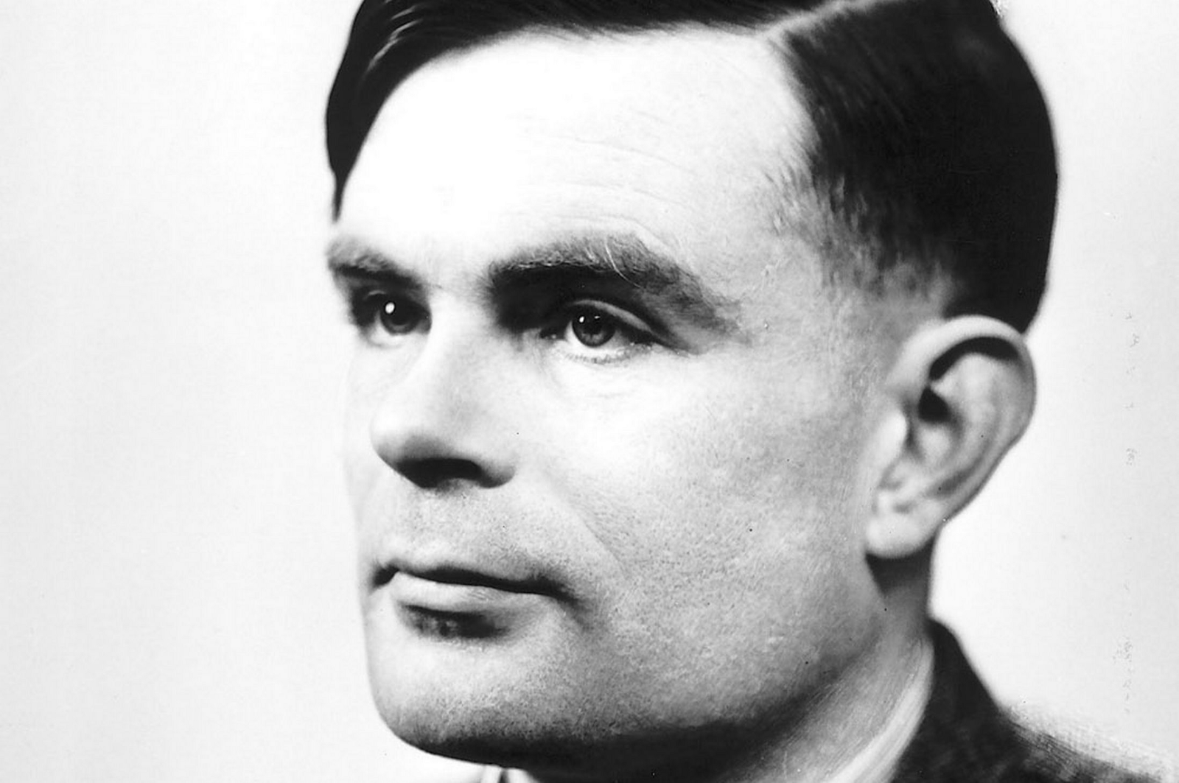
Artificial Intelligence Is Not a New Idea
1950 - Alan Turing’s paper “Computing Machinery and Intelligence”
Asked the question: “Can machines think?”
1956 - John McCarthy coined the phrase a “study of Artificial Intelligence”

Slide 4
AI Terminology
Artificial Intelligence
A program able to perform tasks
normally associated with human intelligence
Machine Learning
A program that can perform
tasks without explicit programming
Deep Learning
A program that uses
artificial neural networks
to learn data representations
and a perform tasks without explicit programming

Slide 5


Expert Systems Encode If-Then Rules
Knowledge Base &
Inference Engine
Query
Input
Advice
Expert
Expert System
Non-Expert

Slide 6
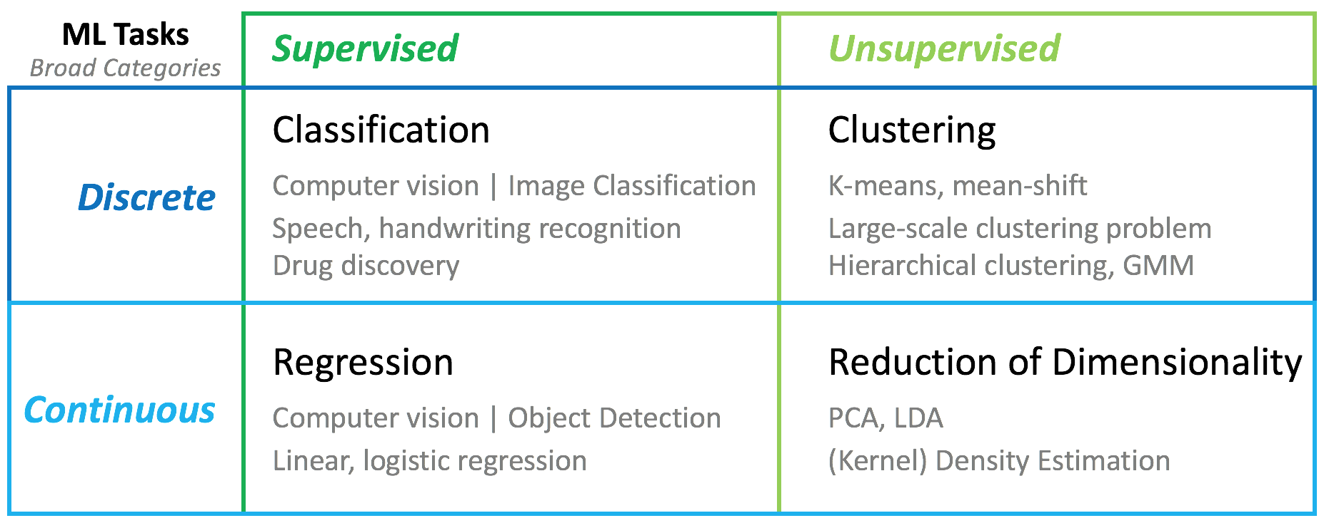
Broad Areas of Machine Learning

Slide 7
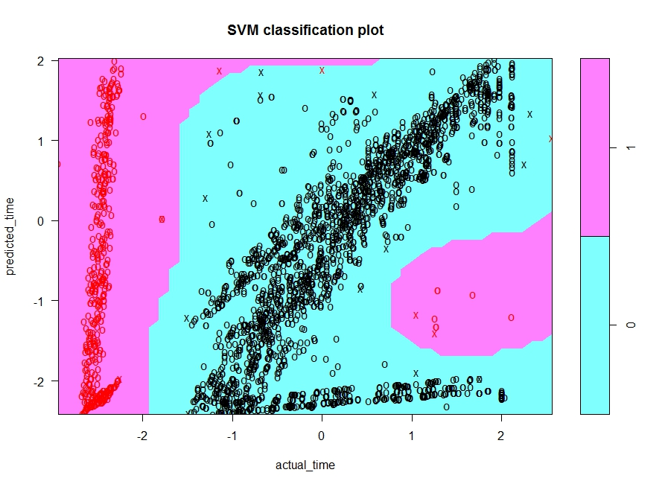
Traditional Machine Learning Anomaly Detection
Support Vector Machine Decision Space
Events that
were too ‘early’
Events that
were too ‘late’
*Red = Anomaly

Slide 8

Machine Vs. Deep Learning
Image courtesy of NVIDIA

Slide 9
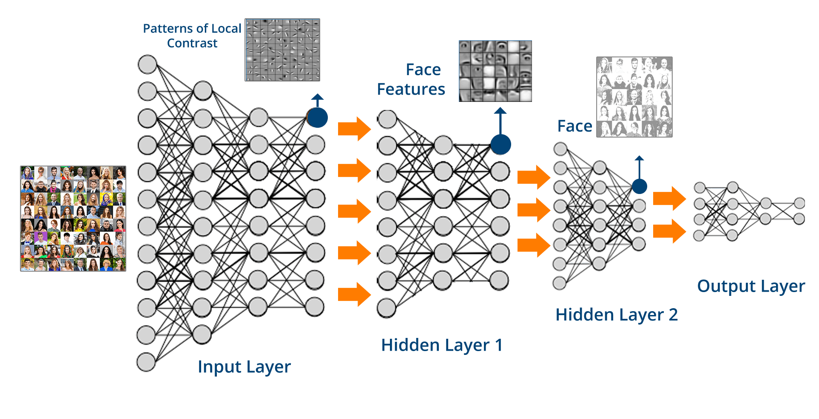
Deep Learning Uses Neural Networks
Image need to cite or remake

Slide 10
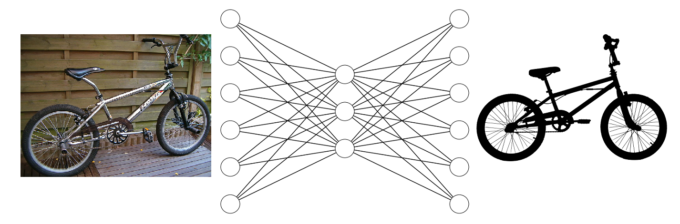
Autoencoders Try to Find the Essential Elements

Slide 11
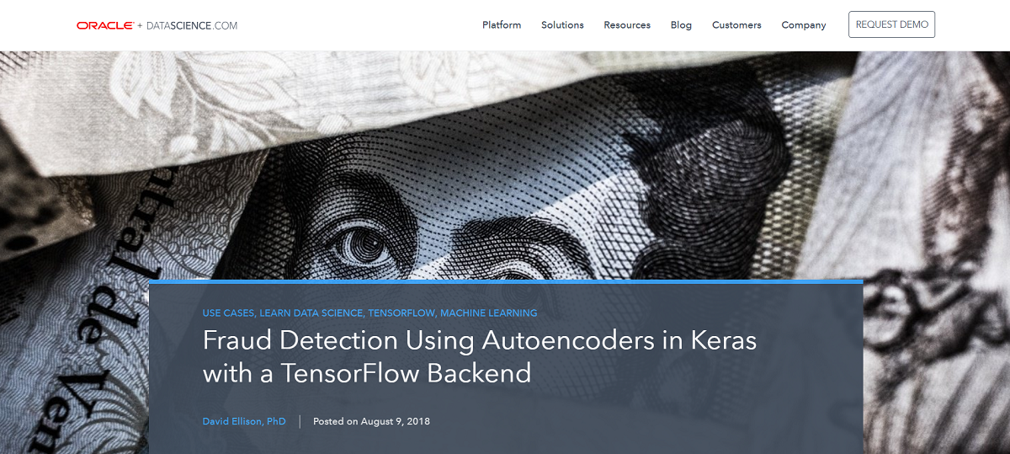
Fraud Detection Use Case
https://www.datascience.com/blog/fraud-detection-with-tensorflow

Slide 12
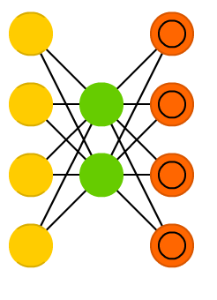
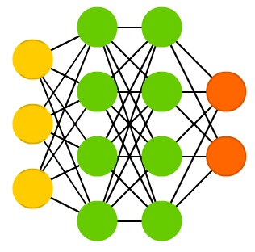
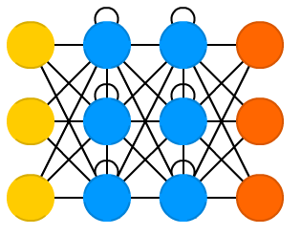
Different Network Architectures Do Different Things
Convolutional Neural Network
(Deep Feed Forward Network)
Recurrent Neural Network
Autoencoders
Notes:
Cite: From the Asimov Institute

Slide 13
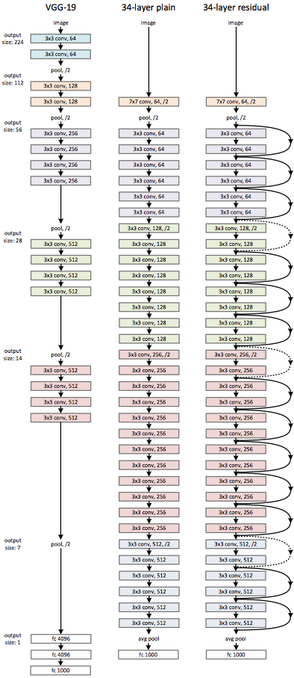
Actual Architectures Are Deep and Complicated
Notes:
Cite: https://medium.com/@14prakash/understanding-and-implementing-architectures-of-resnet-and-resnext-for-state-of-the-art-image-cf51669e1624

Slide 14
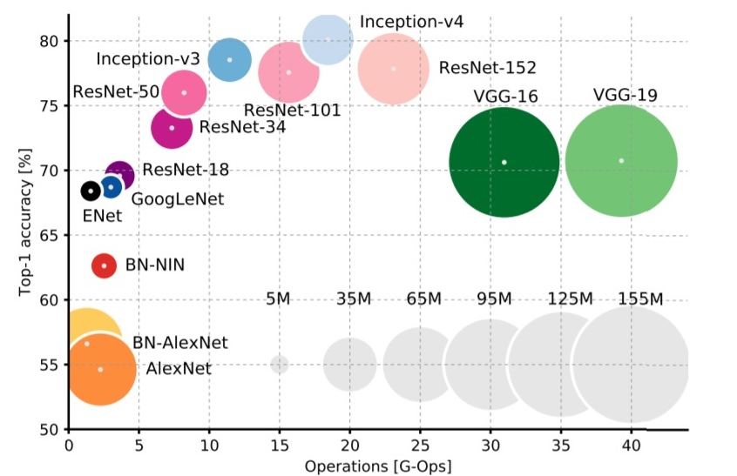
Compute Power Needed for Deep Learning
Notes:
https://towardsdatascience.com/neural-network-architectures-156e5bad51ba

Slide 15
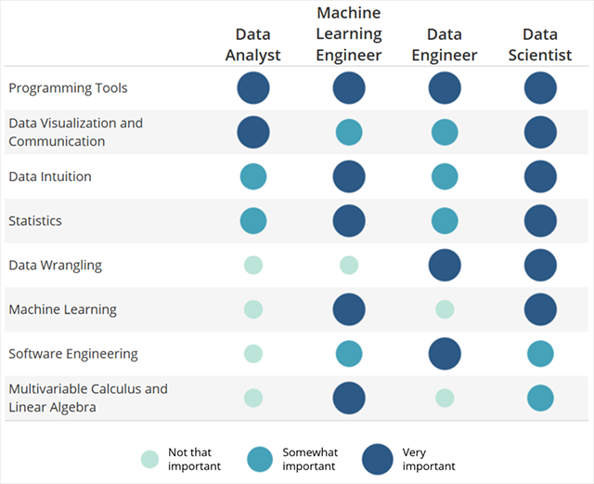
Wide Range of New AI Talent
Source: Udacity, https://blog.udacity.com/2018/01/4-types-data-science-jobs.html

Slide 16
Use Case: Computer Vision
2018 Lenovo Internal. All rights reserved.

Slide 17
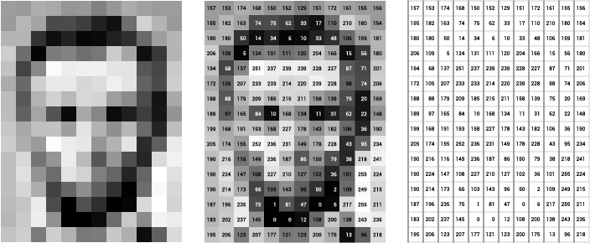
Pixels to Pictures: Images Are Simply Matrixes
Source: OpenFrameWorks
Notes:
Source: https://openframeworks.cc/ofBook/chapters/image_processing_computer_vision.html

Slide 18
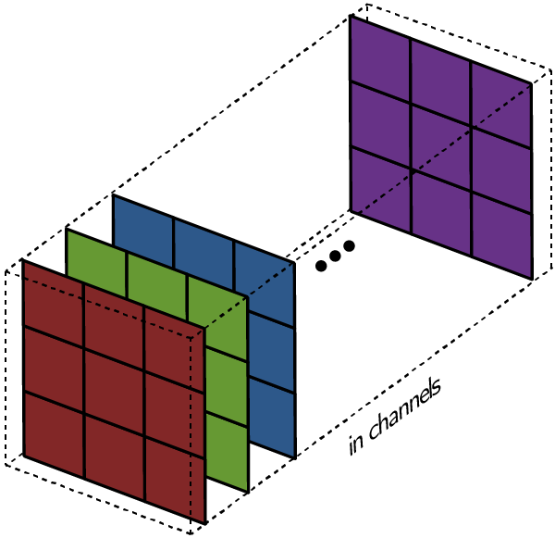
Color Images Are Simply Layers of Matrixes
Source: Towards Data Science
Notes:
By Malvineous - Own work, CC0, https://commons.wikimedia.org/w/index.php?curid=38129628
https://towardsdatascience.com/intuitively-understanding-convolutions-for-deep-learning-1f6f42faee1

Slide 19

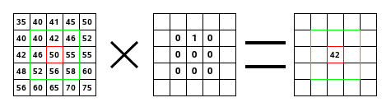
Kernel: A Small Matrix Multiplied over the Image
Source: GNU Image Manipulation Program
Source: OpenCV
Notes:
https://compvisionlab.wordpress.com/2013/04/07/convolution-opencv/
https://docs.gimp.org/en/plug-in-convmatrix.html

Slide 20

Convolution: Process of Moving the Kernel
Source: Towards Data Science
Notes:
https://towardsdatascience.com/intuitively-understanding-convolutions-for-deep-learning-1f6f42faee1

Slide 21
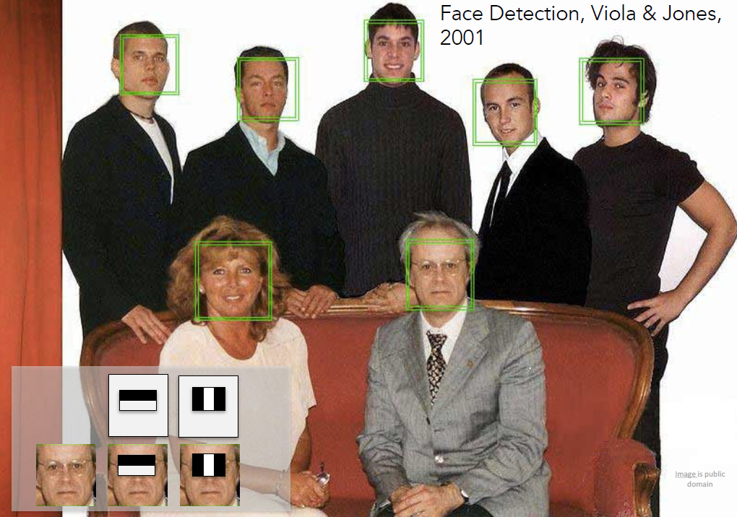
Real Time Face Detection
Source: Stanford CS231n Lectures
Notes:
AdaBoost

Slide 22
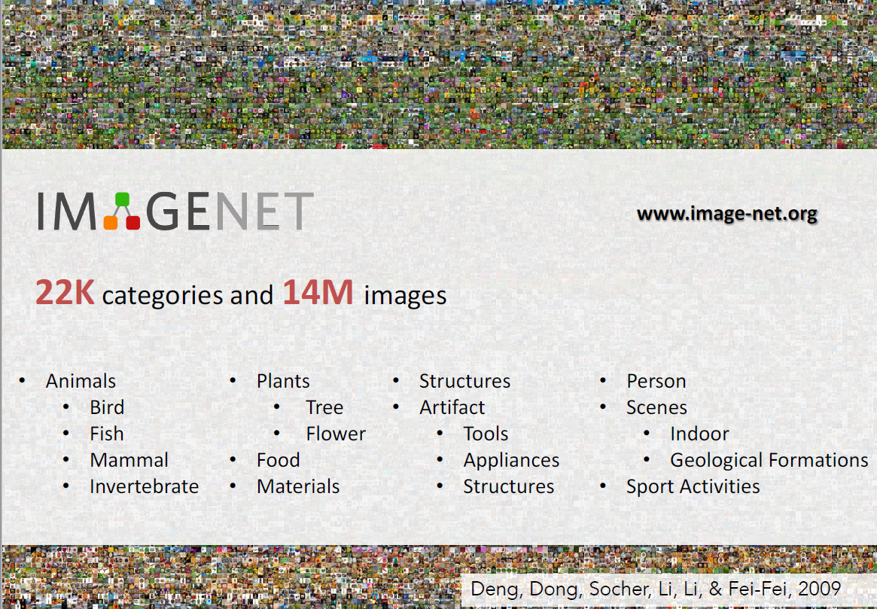
ImageNet: General Object Detection
Source: Stanford CS231n Lectures

Slide 23
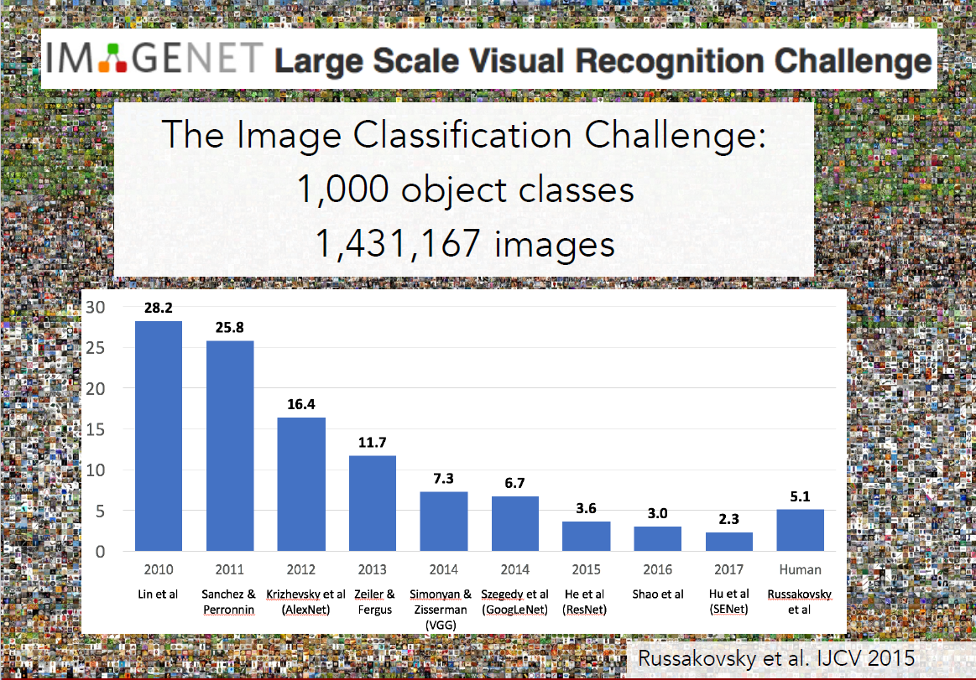
ImageNet: General Object Detection
Source: Stanford CS231n Lectures

Slide 24

Beyond Classification: Localization and Segmentation
Source: Stanford CS231n Lectures
Notes:
http://cs231n.stanford.edu/

Slide 25
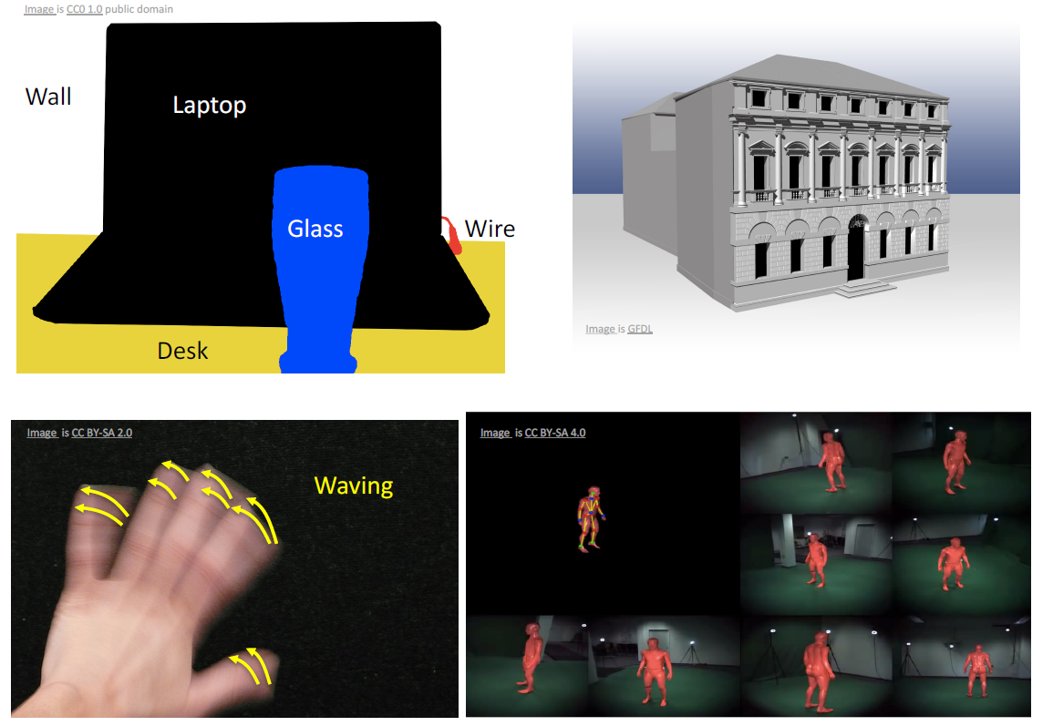
Future of Computer Vision
Source: Stanford CS231n Lectures

Slide 26
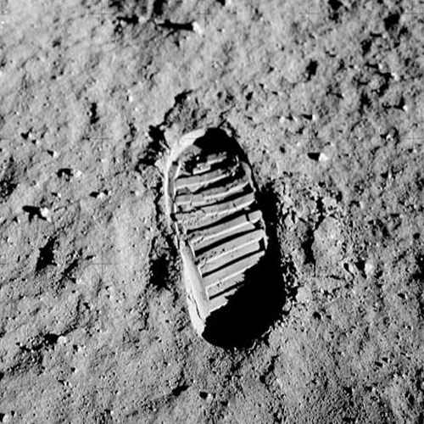
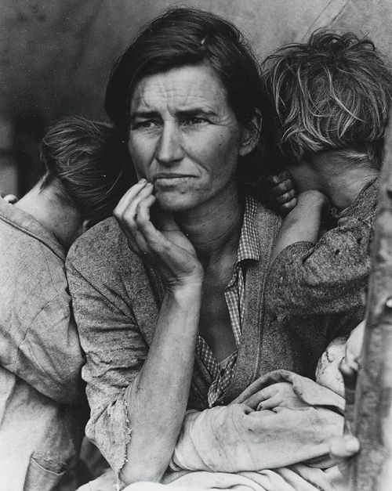
Context and Meaning of Images
Source: Getty Images
Notes:
http://visuallyresponsive.tumblr.com/post/23748320511/motivation

Slide 27
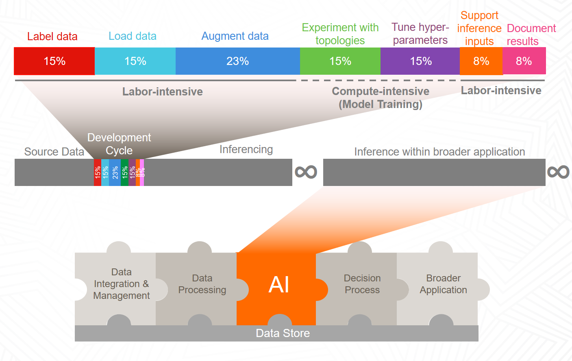
Advanced Computer Vision Will Require “Whole AI Life Cycle” Approaches
Source: Intel Customer Engagements

Slide 28
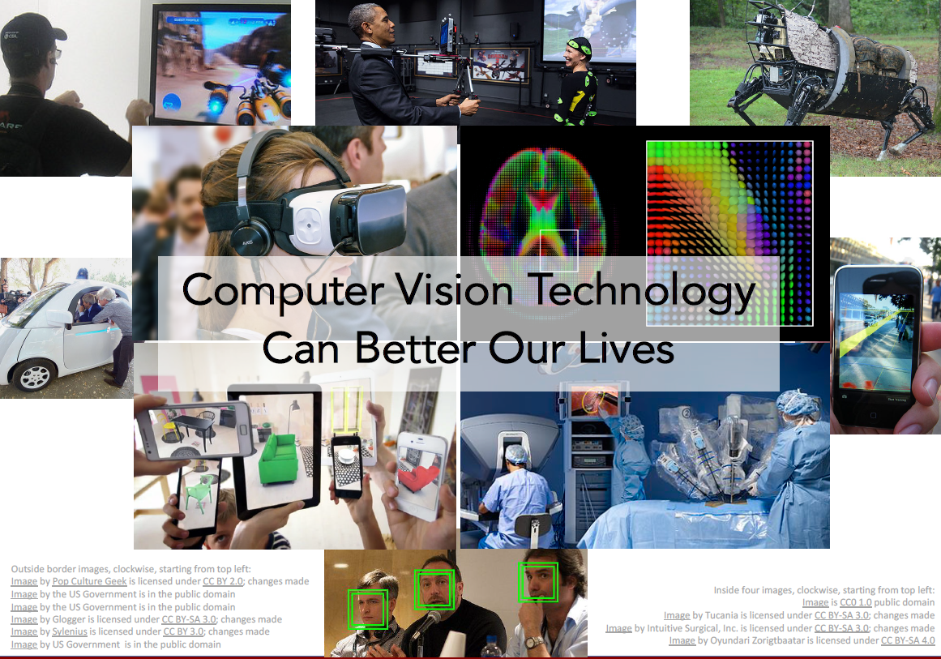
Source: Stanford CS231n Lectures

